Slide 1
DEMO,
Boring template #1
The Second
Adam ‘Two-Names’
Pisky-Nagy

Slide 2
What I learnt?
Honed my presentation skills
My laptop won’t make it
Soda > Non-soda
Can’t fill a whole slide with BS

Slide 3
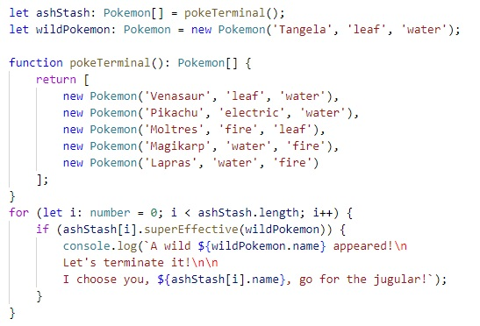
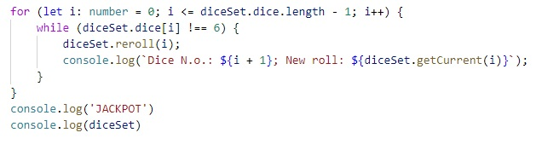
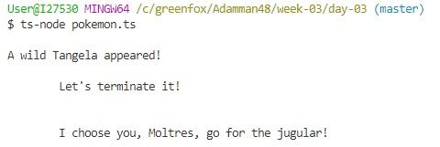
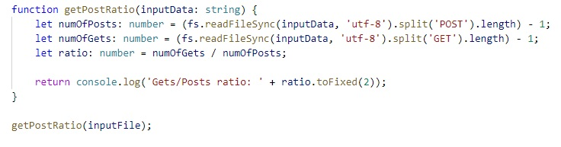
‘What I learnt’ – ‘jokes’ =
IP adress and GET/POST task
Count unique but recurring info
The case of ‘utf-8’…
Good example for ‘while’ within ‘for’
`${Puffin lekvar}`
Easier to pick up if you customize

Slide 4


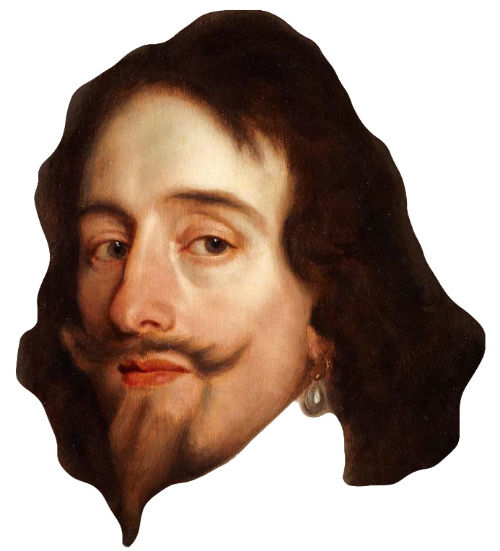
‘What I learnt’ – ‘jokes’ – ‘codes’ =
STOP taking everything as a challenge
Accept the impossible
Perfectionism makes you sad
„King Charles’ head” is a no-go
let it go…

Slide 5


Thanks for the attention!
…or pretending it.

